Slide 1
Computer Vision [H02K5a] Incisor Segmentation
Ramaravind Kommiya Mothilal (r0605648)
Master of Artificial Intelligence (ECS option)
2016-17

Slide 2
Overview
Aligning Landmarks Enhancing Radiographs
Principal Component
Analysis
Initial Estimate
Performance
Landmark points
Radiographs
Training set
Test set
Training set
Test set
Appearance Models
Grey Level Model
Active Shape Model
Test set
Fitting Model iteratively
Test set

Slide 3
Aligning Landmarks:
Aligning Landmarks Enhancing Radiographs
Principal Component
Analysis
Initial Estimate
Performance
Landmark points
Radiographs
Training set
Test set
Training set
Test set
Appearance Models
Grey Level Model
Active Shape Model
Test set
Fitting Model iteratively
Test set

Slide 4
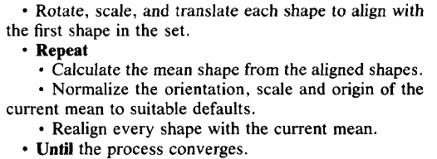
Aligning Landmarks - Procrustes Analysis:
Minimize the squared distances between equivalent points on different shapes
T. F. Cootes, C. J. Taylor, D.H. Cooper, J. Graham. Active Shape Models - Their Training and Application. In Computer Vision and Image Understanding, 61(1):98-59, Jan. 1995
Need to ensure that the algorithm converges
4 (N-1) constraints on 4N variables makes the algorithm ill-conditioned
Some constraints on pose and scale of mean gives a unique solution
Notes:
Protocol [4] of [2] -> Generalised Procrustes Analyses by translating, scaling and rotating the training shapes such that the sum of squares of distances of each shape to the mean D=| xi- x|2is minimised.
State the reference
Highlighted box - why

Slide 5
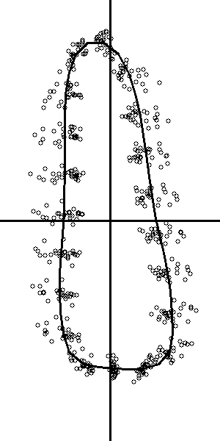
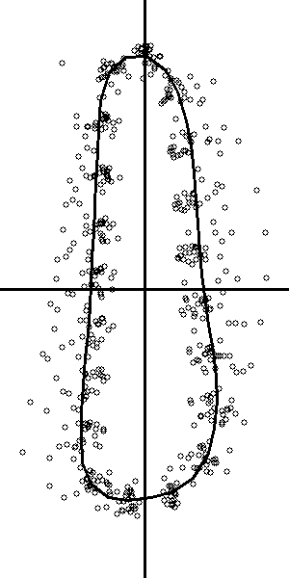
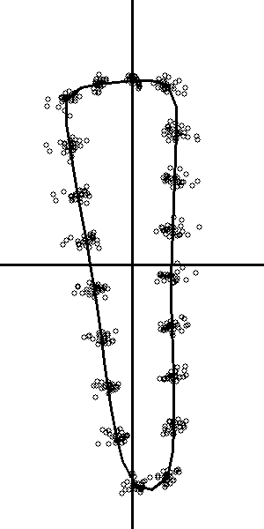
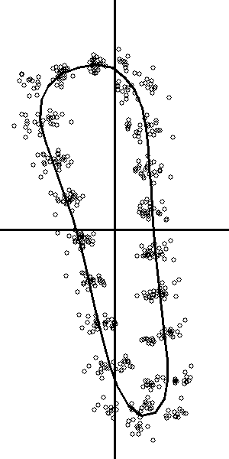
Aligning Landmarks - Procrustes Analysis:
Scatter of some landmark points from the aligned set of each of the incisors, with their respective mean shape overlaid.
Incisor 2 Incisor 4 Incisor 6 Incisor 8
Notes:
Protocol [4] of [2] -> Generalised Procrustes Analyses by translating, scaling and rotating the training shapes such that the sum of squares of distances of each shape to the mean D=| xi- x|2is minimised.
State the reference
Highlighted box - why

Slide 6
Principal Component Analysis:
Aligning Landmarks Enhancing Radiographs
Principal Component
Analysis
Initial Estimate
Performance
Landmark points
Radiographs
Training set
Test set
Training set
Test set
Appearance Models
Grey Level Model
Active Shape Model
Test set
Fitting Model iteratively
Test set

Slide 7
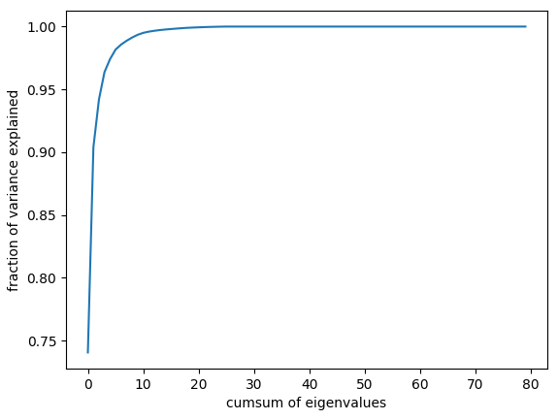
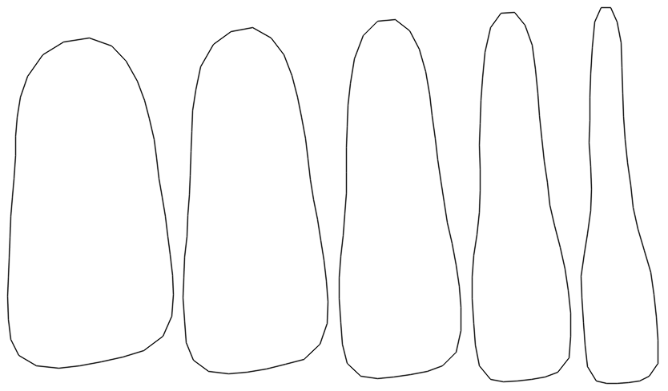
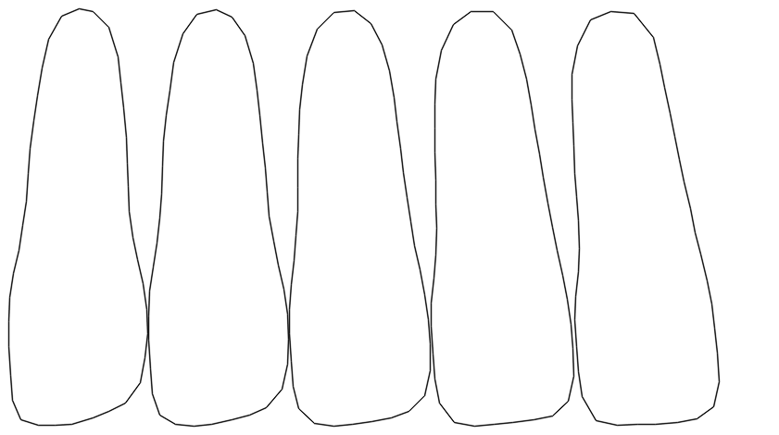
Principal Component Analysis:
Landmark points are partially correlated
PCA gives a “mode of variation”, a way in which the landmark points tend to move together as the shape varies
b₁ b₂
-2√λ₁ <---------------- b₁------------------->+2√λ₁ -2√λ₂ <---------------- b₂------------------->+2√λ₂
Notes:
Fig: : Effect of varying First and Second Principal Component between -2 and 2 standard deviations of third incisor’s mode
first PC explains the width of the incisor while the second component explains its skewness. While these interpretations hold for every incisor models, the other PCs explain minor shape variations which are characteristic of each incisors

Slide 8
Active Shape Model:
Aligning Landmarks Enhancing Radiographs
Principal Component
Analysis
Initial Estimate
Performance
Landmark points
Radiographs
Training set
Test set
Training set
Test set
Appearance Models
Grey Level Model
Active Shape Model
Test set
mean shape & modes of variation
Fitting Model iteratively
Test set
Notes:
Thus an Active Shape Model for an incisor, so developed, consists of its mean shape and has number of parameters which control the main modes of variation in ways found in the training set.

Slide 9
Enhancing Radiographs:
Aligning Landmarks Enhancing Radiographs
Principal Component
Analysis
Initial Estimate
Performance
Landmark points
Radiographs
Training set
Test set
Training set
Test set
Appearance Models
Grey Level Model
Active Shape Model
Test set
Fitting Model iteratively
Test set

Slide 10
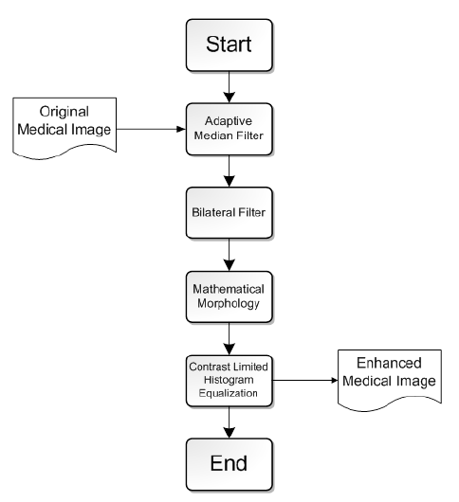
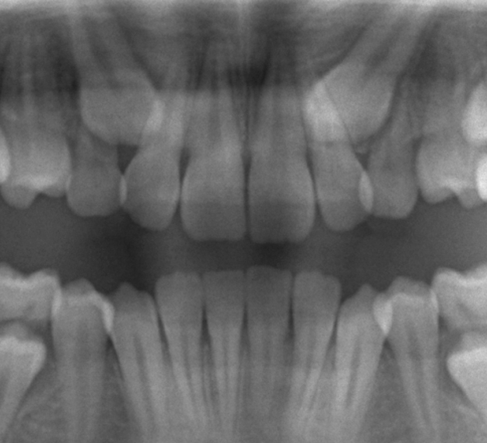
Enhancing Radiographs:
Purpose:
Noise suppression Contrast Enhancement
To ensure that the noises in the image are not amplified avoiding any possible distortion of the image.
Original Image
R.-Y. Huang, L.-R. Dung, C.-F. Chu, and Y.-Y. Wu. Noise removal and contrast enhancement for x-ray images. Journal of Biomedical Engineering and Medical Imaging, 3(1):56-67, Feb. 2016.
Notes:
we ensure that the region of the radiograph containing teeth is high in contrast relative to the rest of the image and is also less noisy, then the task at hand becomes easy.

Slide 11

Enhancing Radiographs - Adaptive Median Filter:
Original Image
Adaptive Median Filter
Removes impulsive noise.
R.-Y. Huang, L.-R. Dung, C.-F. Chu, and Y.-Y. Wu. Noise removal and contrast enhancement for x-ray images. Journal of Biomedical Engineering and Medical Imaging, 3(1):56-67, Feb. 2016.

Slide 12

Enhancing Radiographs - Bilateral Filter:
Original Image
Bilateral Filter
Handles gaussian noise while preserving the edges in the image.
R.-Y. Huang, L.-R. Dung, C.-F. Chu, and Y.-Y. Wu. Noise removal and contrast enhancement for x-ray images. Journal of Biomedical Engineering and Medical Imaging, 3(1):56-67, Feb. 2016.

Slide 13
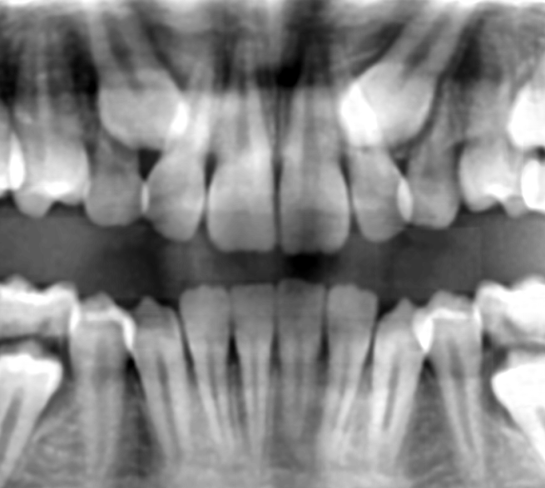
Enhancing Radiographs - Mathematical Morphology:
Original Image
Top-hat transform & Bottom-hat transform
Enhances Contrast
R.-Y. Huang, L.-R. Dung, C.-F. Chu, and Y.-Y. Wu. Noise removal and contrast enhancement for x-ray images. Journal of Biomedical Engineering and Medical Imaging, 3(1):56-67, Feb. 2016.
Notes:
Can add top and bottom hat separaetly

Slide 14
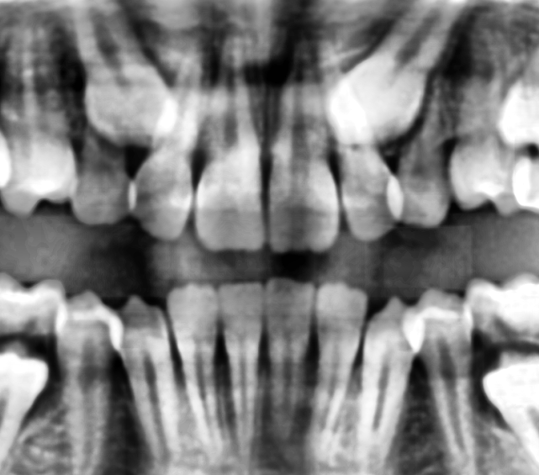
Enhancing Radiographs - CLAHE:
Original Image
Contrast Limited Adaptive Histogram Equalization
Enhances Contrast
R.-Y. Huang, L.-R. Dung, C.-F. Chu, and Y.-Y. Wu. Noise removal and contrast enhancement for x-ray images. Journal of Biomedical Engineering and Medical Imaging, 3(1):56-67, Feb. 2016.
Notes:
Compare with other AHE methods. Can refer to that paper.

Slide 15
Initial Estimate:
Aligning Landmarks Enhancing Radiographs
Principal Component
Analysis
Initial Estimate
Performance
Landmark points
Radiographs
Training set
Test set
Training set
Test set
Appearance Models
Grey Level Model
Active Shape Model
Test set
Fitting Model iteratively
Test set
Notes:
Thus an Active Shape Model for an incisor, so developed, consists of its mean shape and has number of parameters which control the main modes of variation in ways found in the training set.

Slide 16
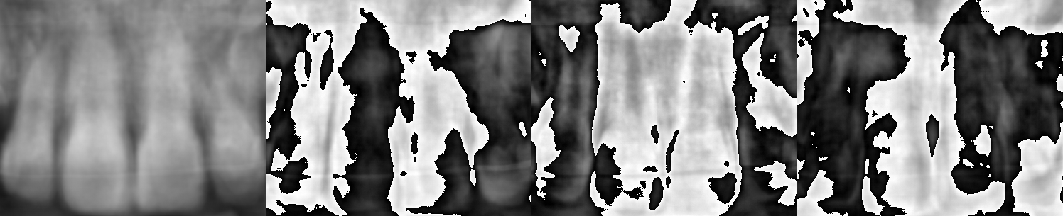
Initial Estimate:
Finding Initial Estimate
Appearance Model Search Region Jaw split
Upper Incisors
Lower Incisors

Slide 17
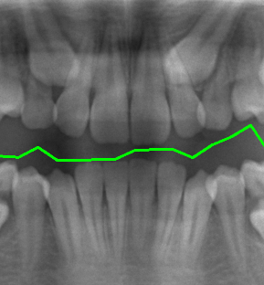
Initial Estimate:
Finding Initial Estimate
Appearance Model Search Region Jaw split Width
Height
Image’s vertical axis
Gaussian Filter + Intensity Histogram
=
Jaw Split
Notes:
Some lines about jaw split

Slide 18
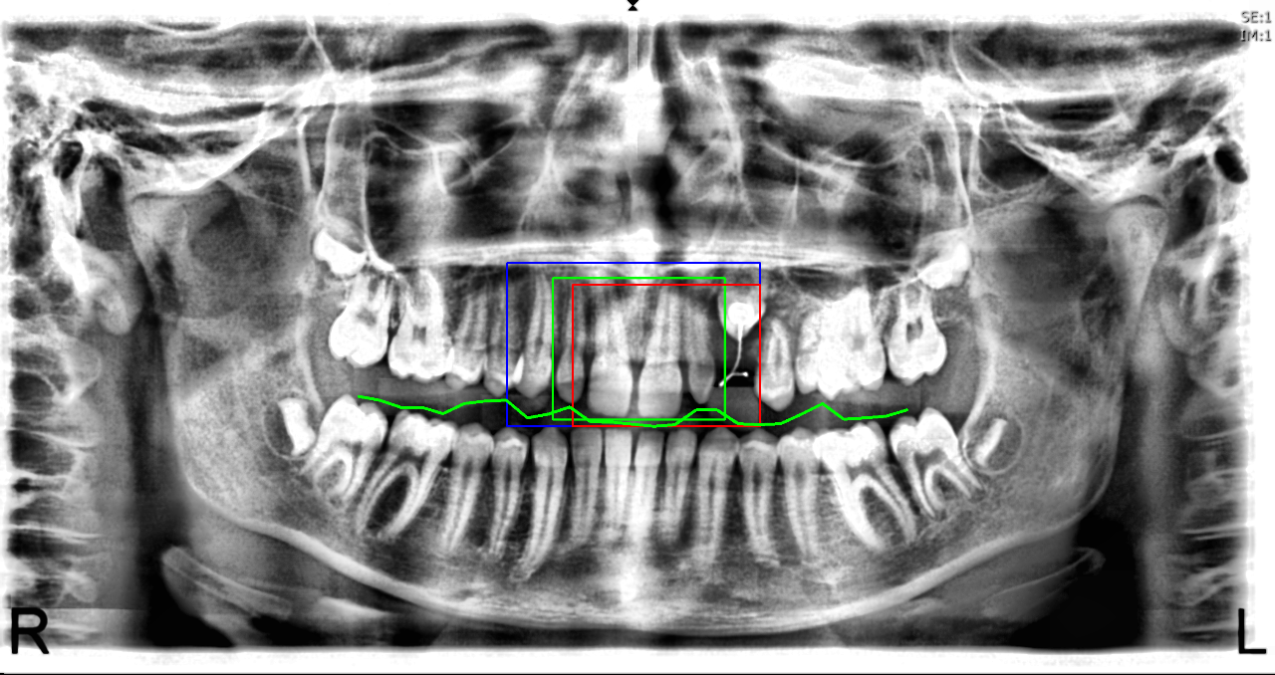
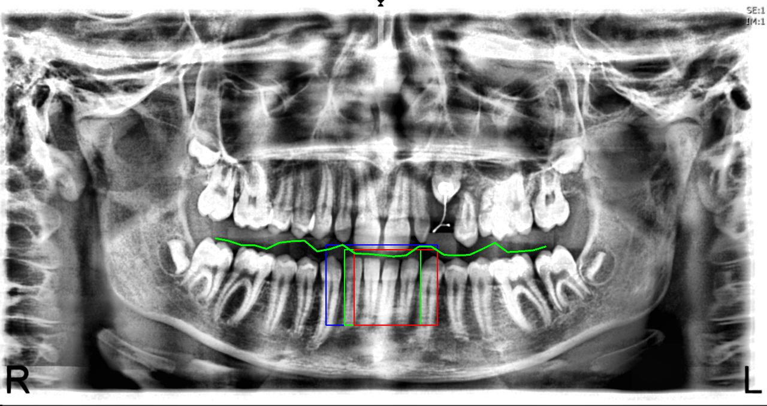
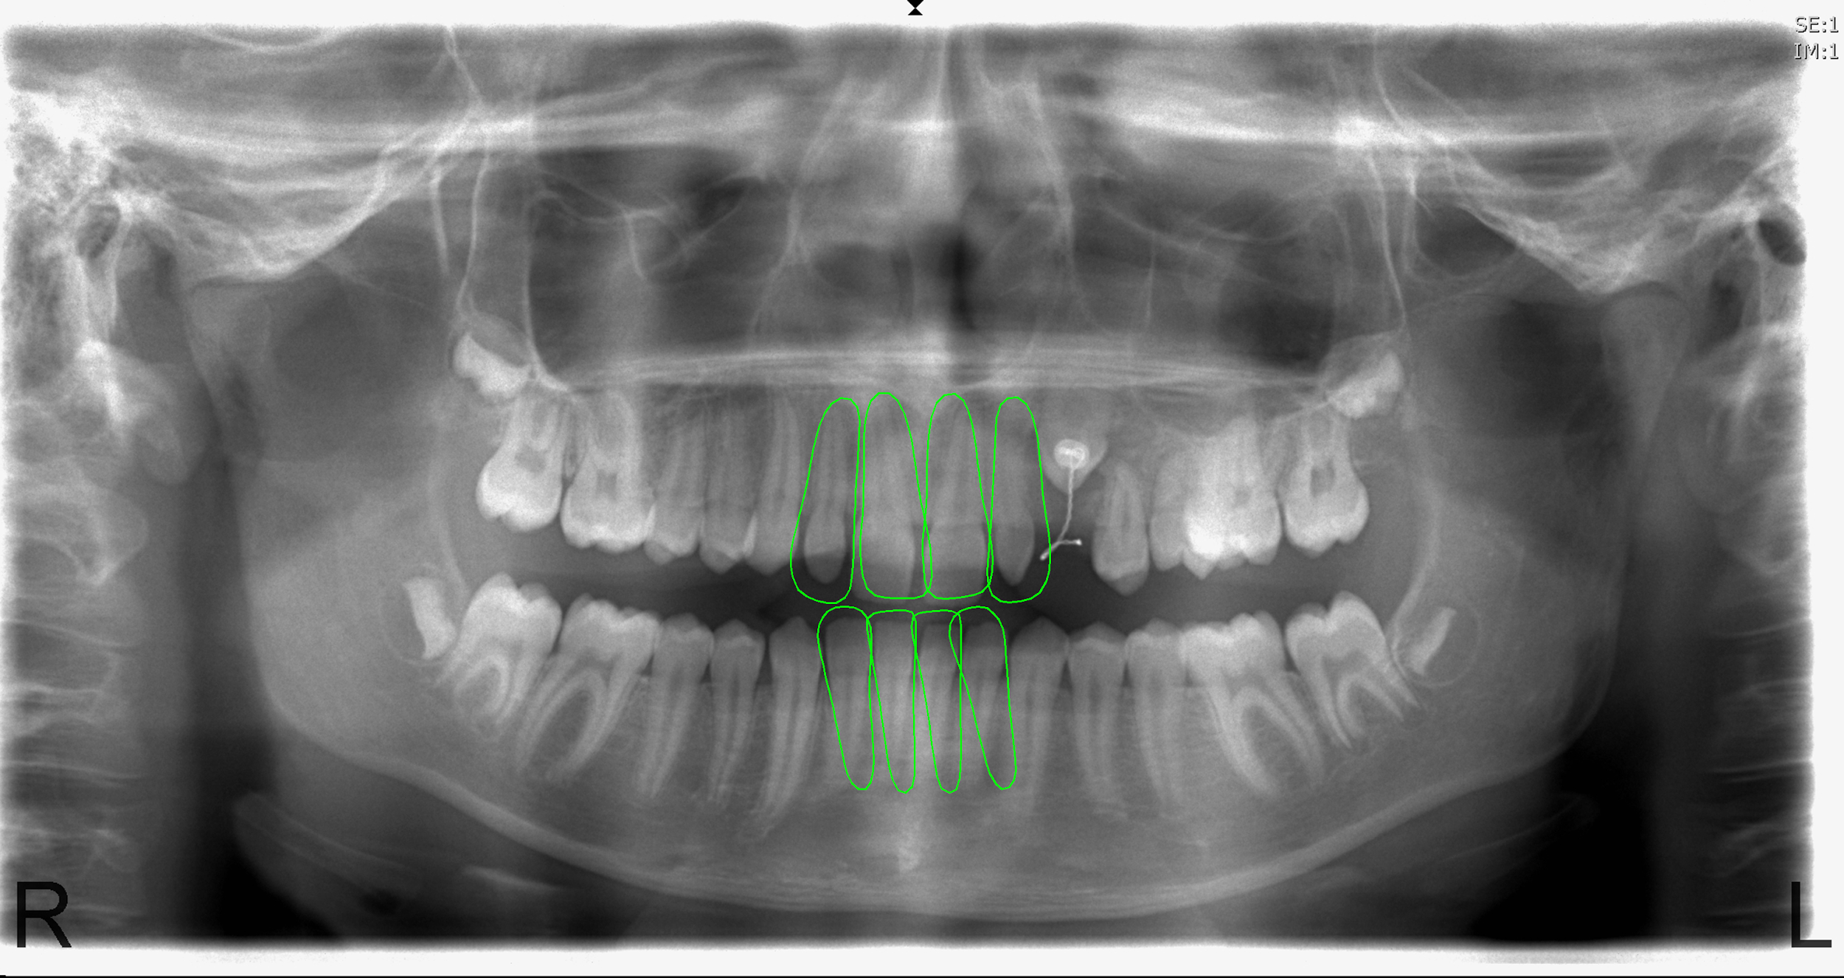
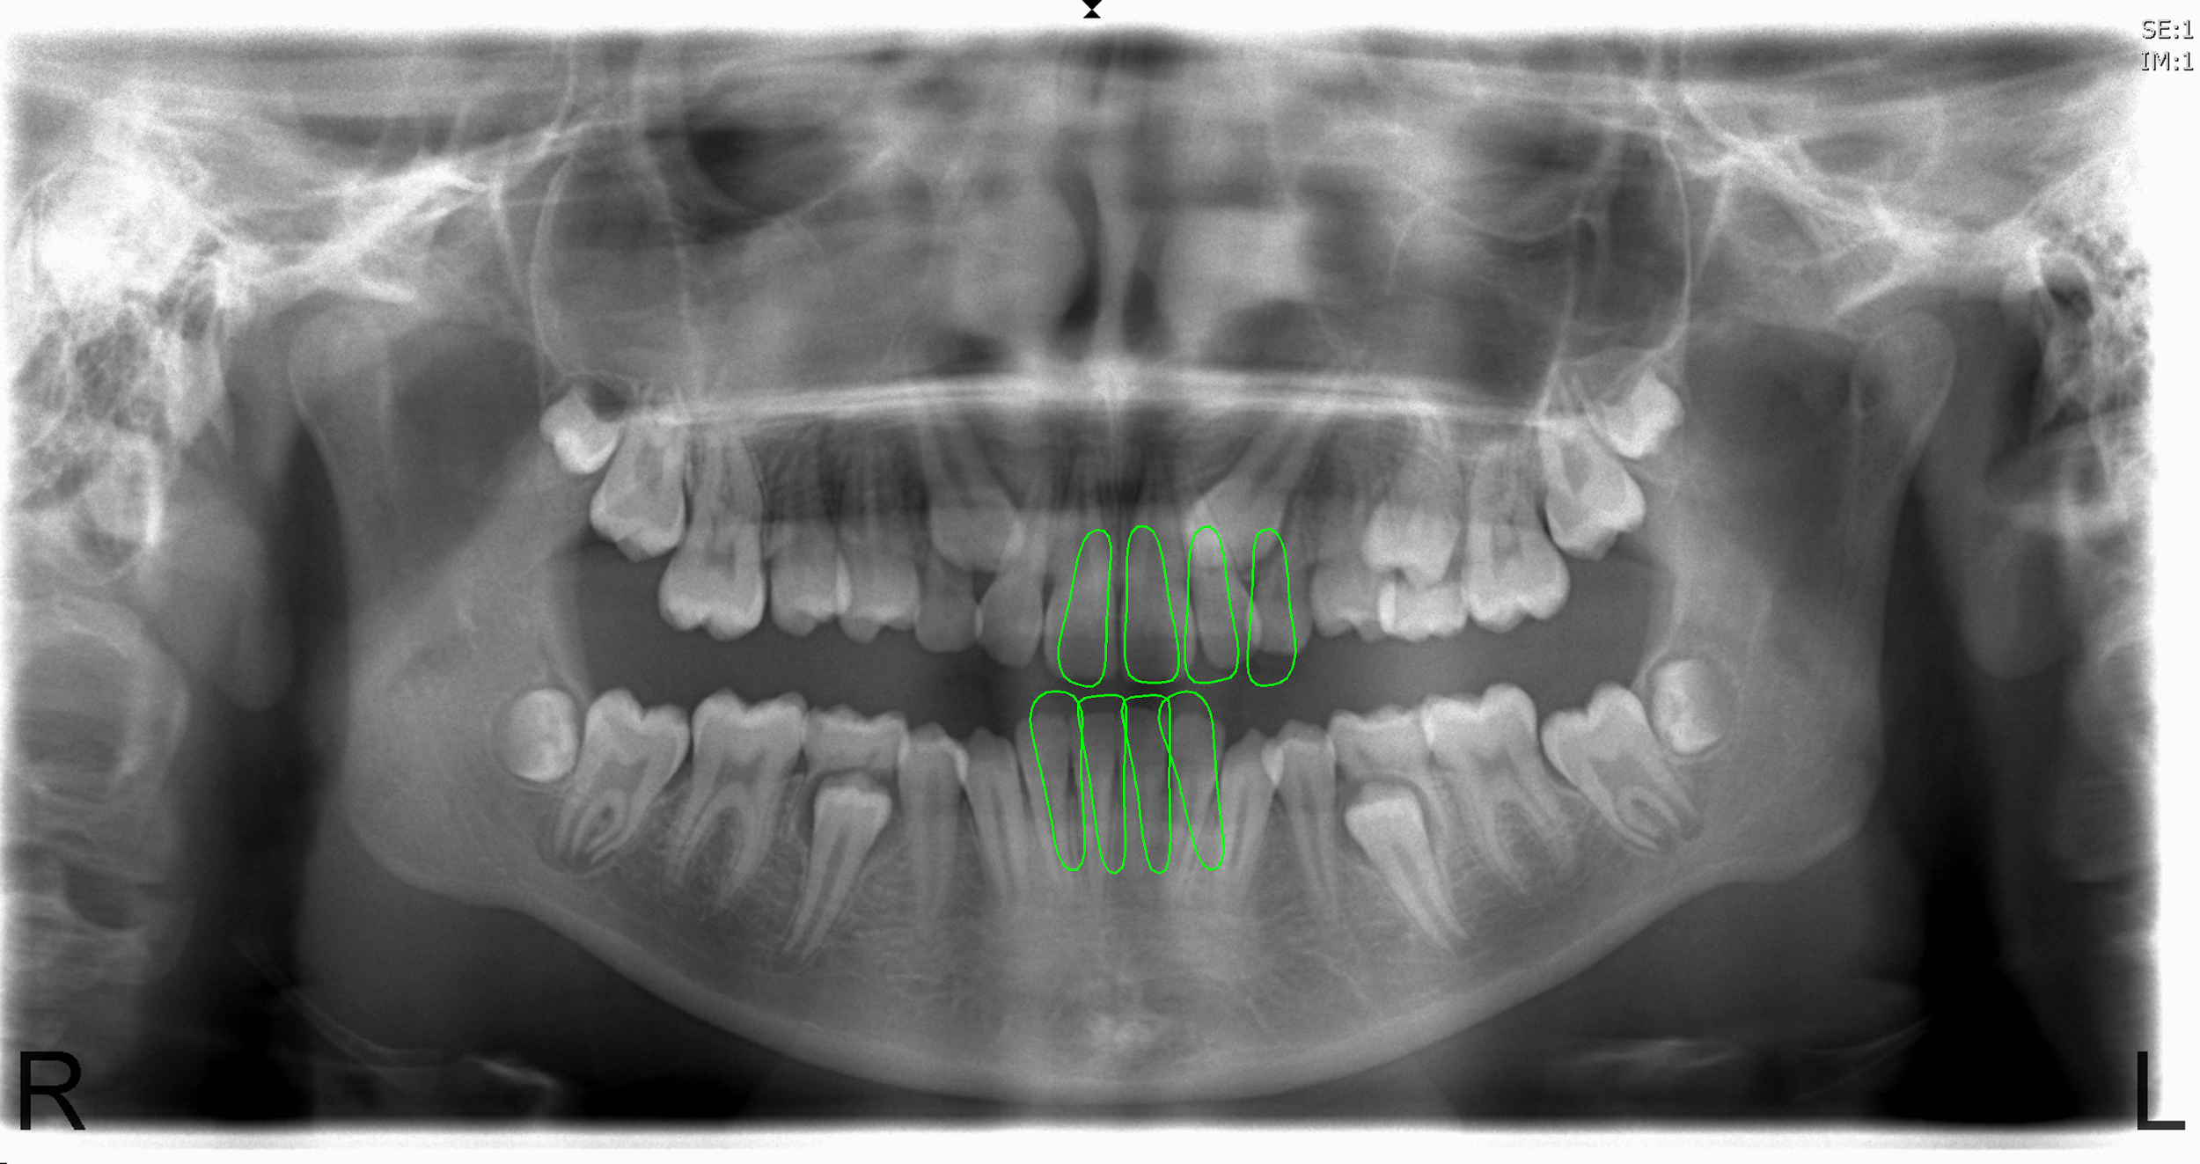
Initial Estimate - Results:
Finding initial estimate for upper incisors Finding initial estimate for lower incisors
Initial estimate for radiograph 02 Initial estimate for radiograph 06
Notes:
Finding Initial Estimate. (a),(b) - Process (Blue-search region; Green-Best match so far; Red-Moving window) and (c),(d) - Good and Bad results respectively.

Slide 19
Grey Level Model:
Aligning Landmarks Enhancing Radiographs
Principal Component
Analysis
Initial Estimate
Performance
Landmark points
Radiographs
Training set
Test set
Training set
Test set
Appearance Models
Grey Level Model
Active Shape Model
Test set
Fitting Model iteratively
Test set
Notes:
Thus an Active Shape Model for an incisor, so developed, consists of its mean shape and has number of parameters which control the main modes of variation in ways found in the training set.

Slide 20
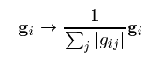
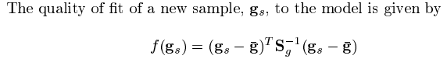
Grey Level Model:
Represents the local grey-level structure of a target object in an image
For each model point, repeating for each training image
Sample the gradients of ‘k’ pixels on either side
Normalize
Estimate their mean and covariance
Gives a statistical model for the grey-level profile about the point
Notes:
Assuming they are multivariate gaussian, a statistical; model is derived

Slide 21
Fitting Model Iteratively:
Aligning Landmarks Enhancing Radiographs
Principal Component
Analysis
Initial Estimate
Performance
Landmark points
Radiographs
Training set
Test set
Training set
Test set
Appearance Models
Grey Level Model
Active Shape Model
Test set
Fitting Model iteratively
Test set
Notes:
Thus an Active Shape Model for an incisor, so developed, consists of its mean shape and has number of parameters which control the main modes of variation in ways found in the training set.

Slide 22
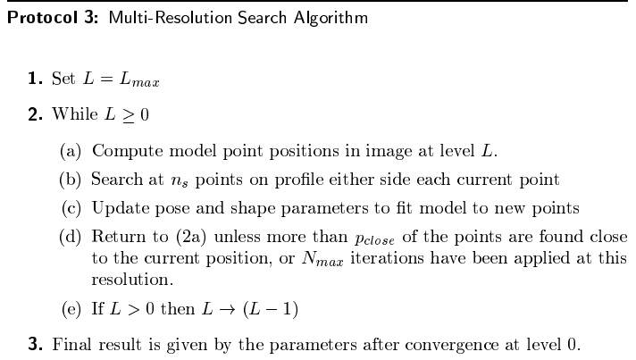
Fitting Model Iteratively:
Implemented Active Shape Algorithm in Multi-Resolution Framework
Levels - 2:
More levels make incisor boundaries diffuse into each other
A small addition: Applied a Median Filter of length 5 to get smooth boundary
T. Cootes. An introduction to Active Shape Models. In Image Processing and Analysis, pages 223–248. 2000.
Notes:
Assuming they are multivariate gaussian, a statistical; model is derived

Slide 23
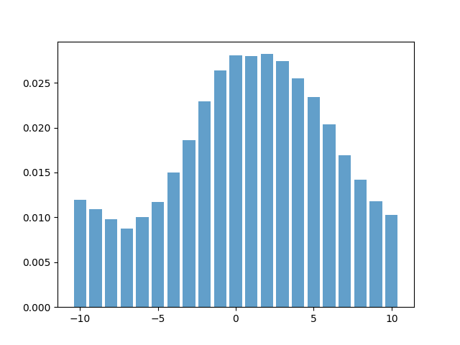
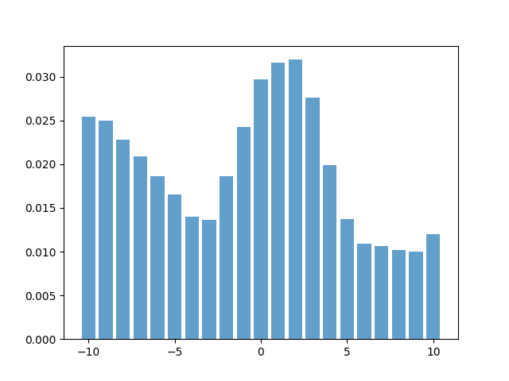
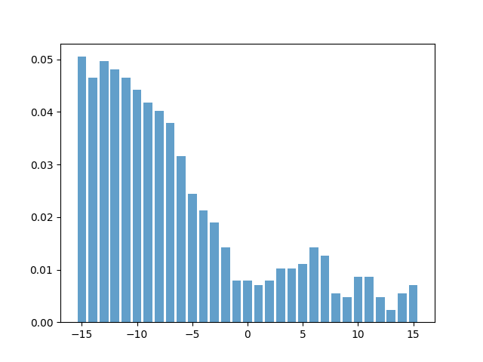
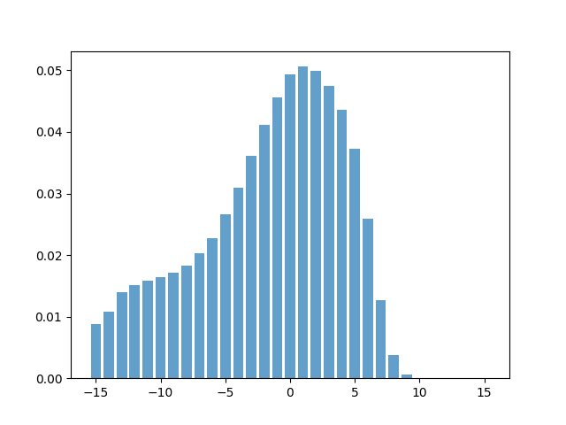
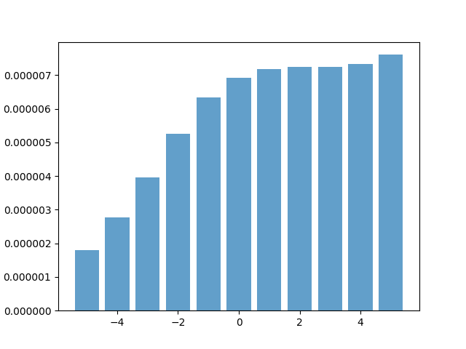
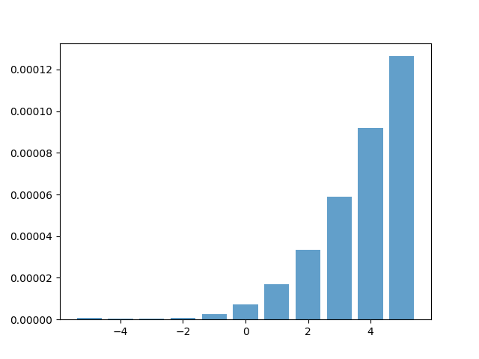
Fitting Model Iteratively - Grey Level Profile and Search:
Level 0
Level 1
Model Profile
Sample Profile
Cost of Fit
Notes:
Assuming they are multivariate gaussian, a statistical; model is derived

Slide 24
Fitting Model Iteratively:
Update of model parameters:
Scale : 20% change; Rotation : 45°; Shape parameters : -3𝜎 to +3𝜎
Convergence Decision:
Record the number of times that the best found pixels along a search profile is within the central 25% of the profile.
Crown part of the incisors is easily distinguishable compared to the root part
More probability to lie within the central 25% of the profile
Therefore, if at least 50% of the points are found within the central 25% of the profile, the algorithm is declared to have converged at that resolution
T. Cootes. An introduction to Active Shape Models. In Image Processing and Analysis, pages 223–248. 2000.

Slide 25
Results Evaluation:
Aligning Landmarks Enhancing Radiographs
Principal Component
Analysis
Initial Estimate
Performance
Landmark points
Radiographs
Training set
Test set
Training set
Test set
Appearance Models
Grey Level Model
Active Shape Model
Test set
Fitting Model iteratively
Test set

Slide 26

Results Evaluation:
Dice Coefficient
Measures the similarity between two binary images
More similar to Precision than Accuracy
‘A’ - Binary image, white pixels defined by ground truth landmark points
‘B’ - Binary image, white pixels defined by landmark points given by model
‘TP, FP, FN’ - True Positive, False Positive and False Negative respectively
Test set
Notes:
Dice coefficient, which measures the similarity between two objects, is used to quantify the performance of our algorithm
Thus it is more similar to precision than accuracy which is the appropriate evaluation metric for this project.

Slide 27
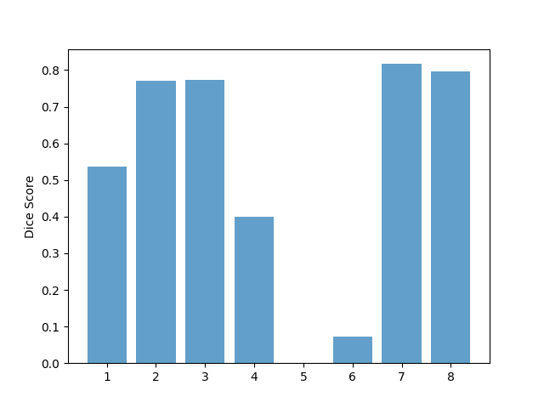
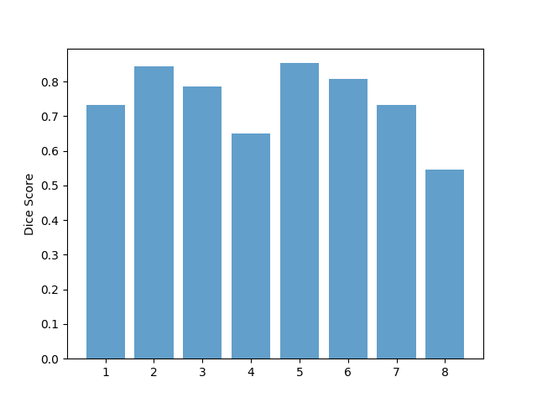
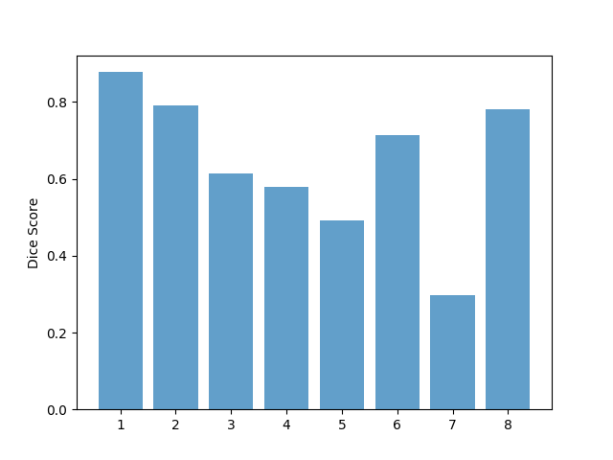
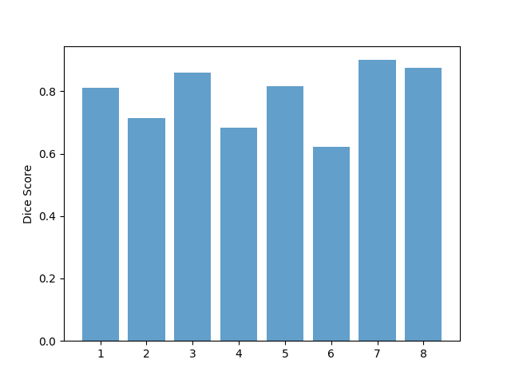
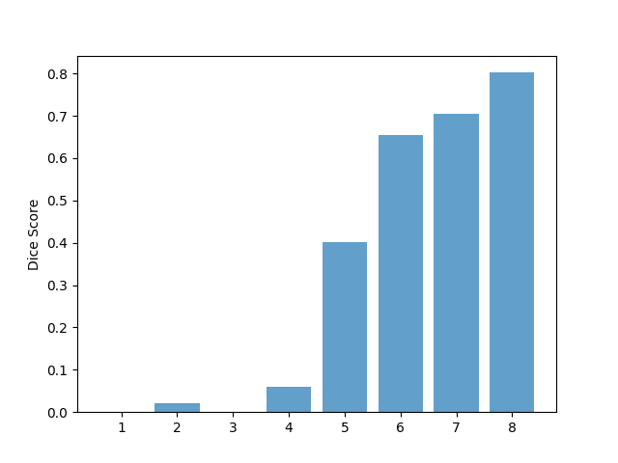
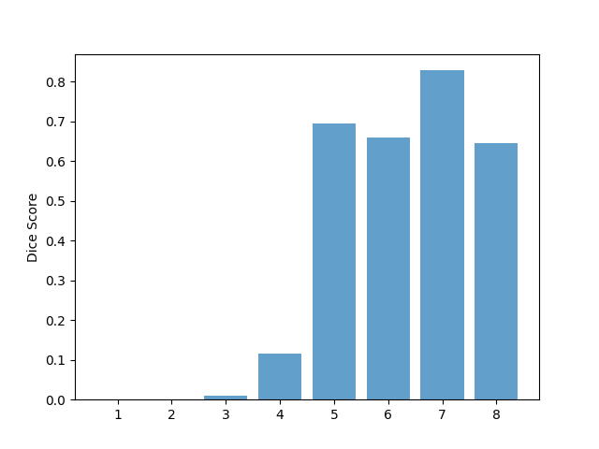
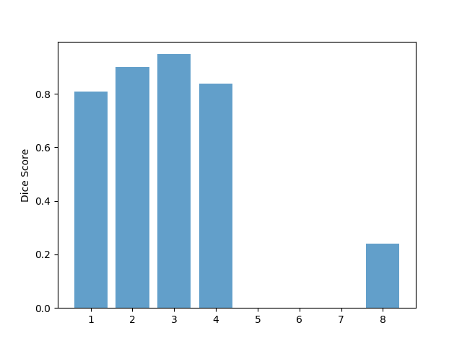
Results Evaluation: Leave-One-Out-Cross Validation
Radiograph 01
Radiograph 02
Radiograph 03
Radiograph 04
Radiograph 05
Radiograph 06
Radiograph 07
Notes:
Given 14 radiograph images and their landmark points, the active shape model developed for each of the incisors is evaluated using Leave-One-Out cross validation method. Each one of the 14 provided images is used once as the testing image, while the others are used as training set.

Slide 28
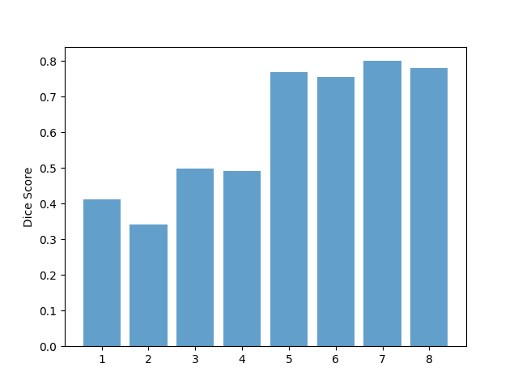
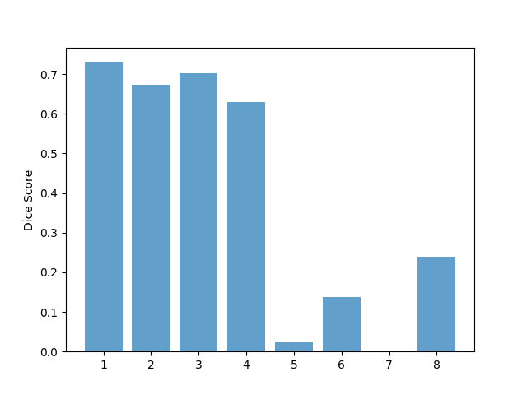
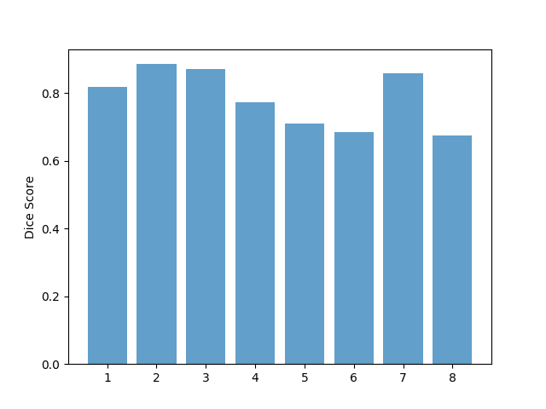
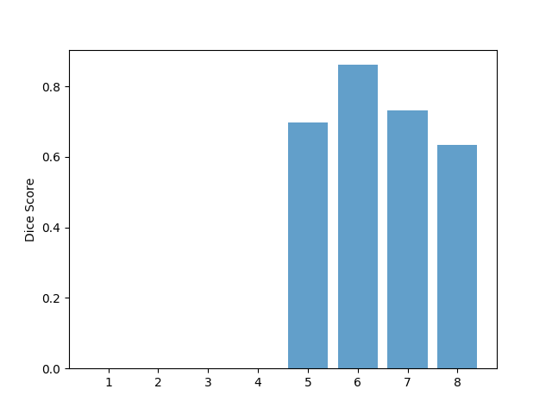
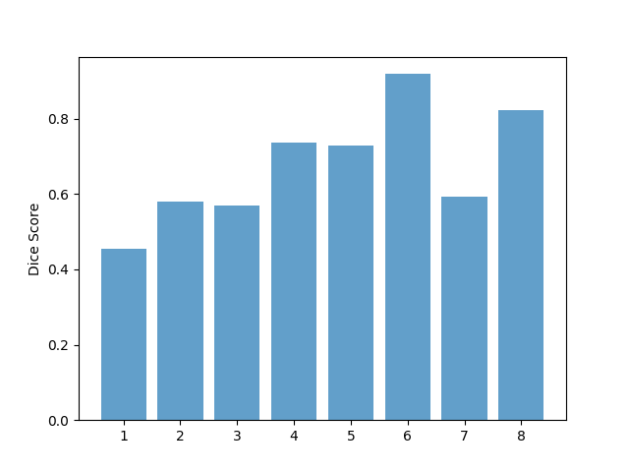
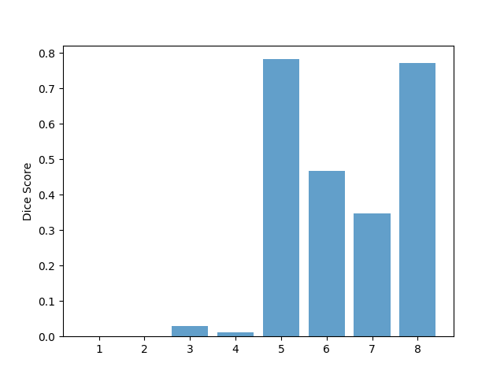
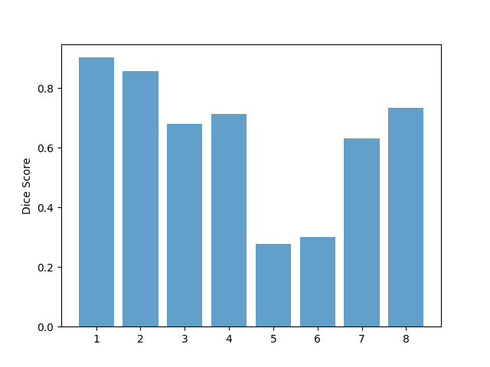
Results Evaluation: Leave-One-Out-Cross Validation
Radiograph 08
Radiograph 09
Radiograph 10
Radiograph 11
Radiograph 12
Radiograph 13
Radiograph 14
Notes:
Dice coefficient, which measures the similarity between two objects, is used to quantify the performance of our algorithm
Thus it is more similar to precision than accuracy which is the appropriate evaluation metric for this project.

Slide 29
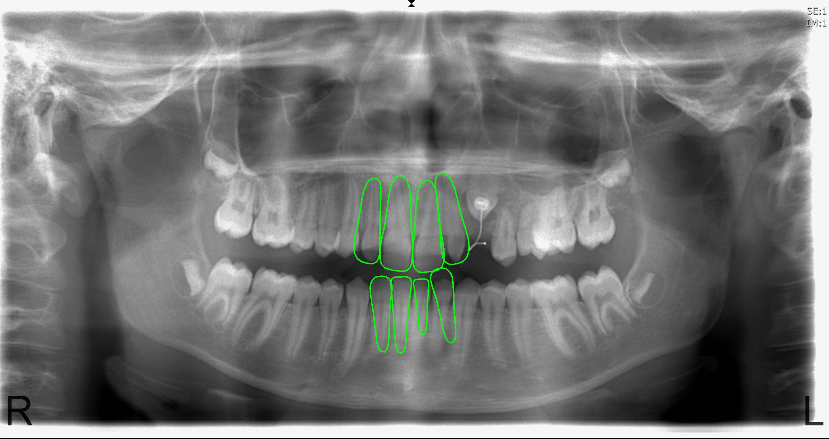
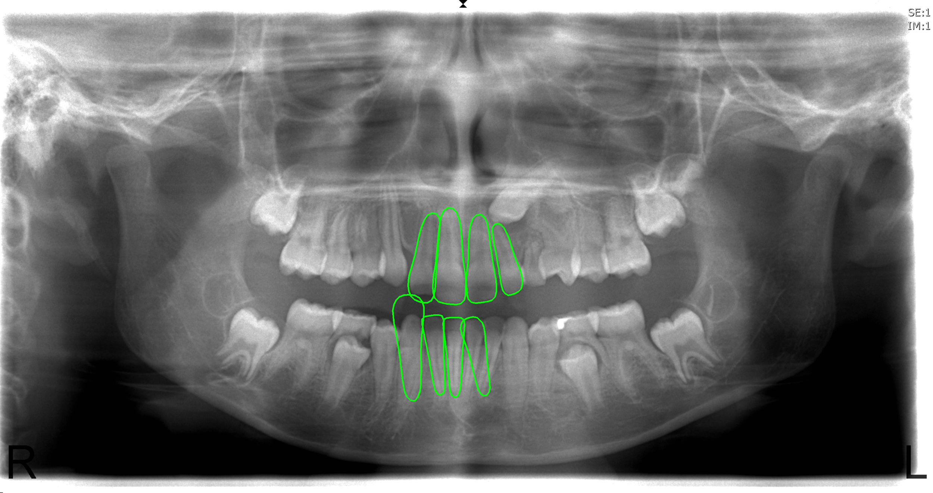
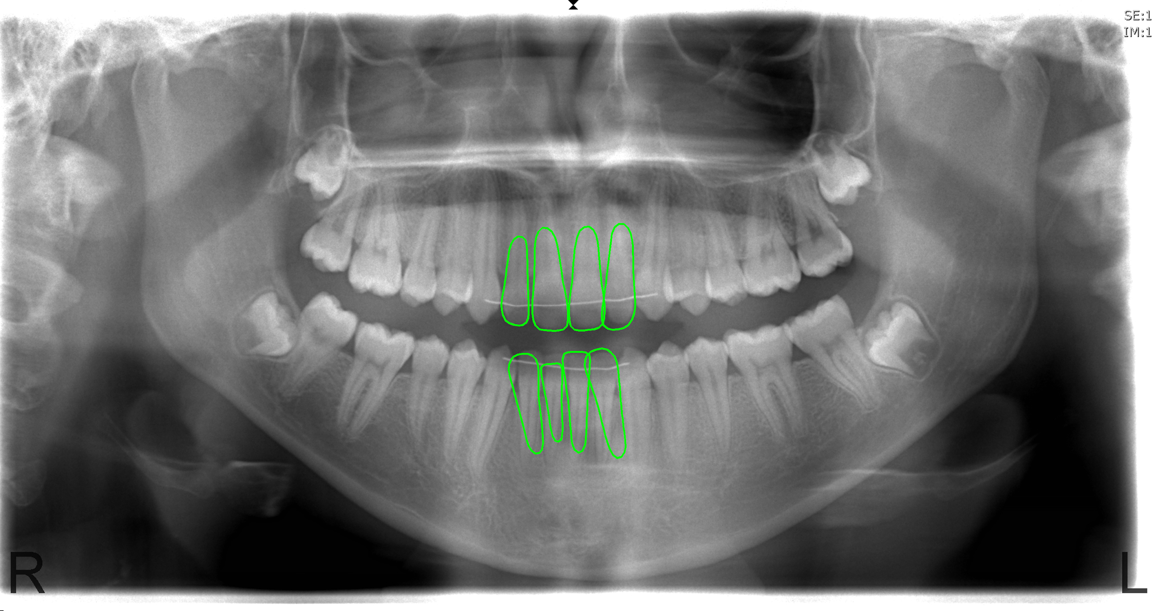
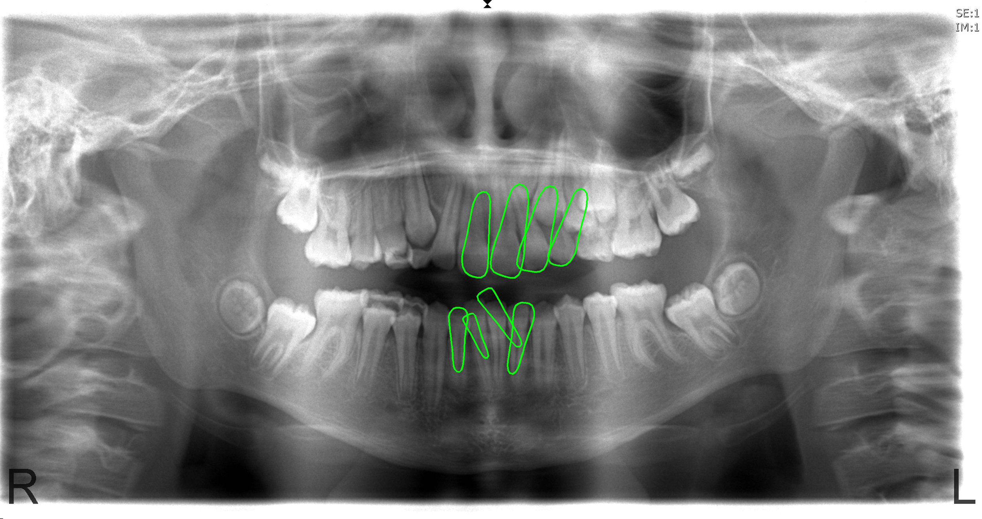
Results Evaluation:
Bad Results Auto Initialisation
Good Results
Radiograph 02
Radiograph 07
Radiograph 10
Radiograph 13
Notes:
Models diverged to neighbouring lower incisors in 07 and to neighbouring upper incisors in 13

Slide 30
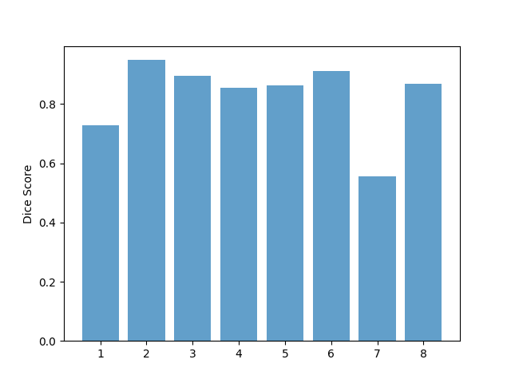
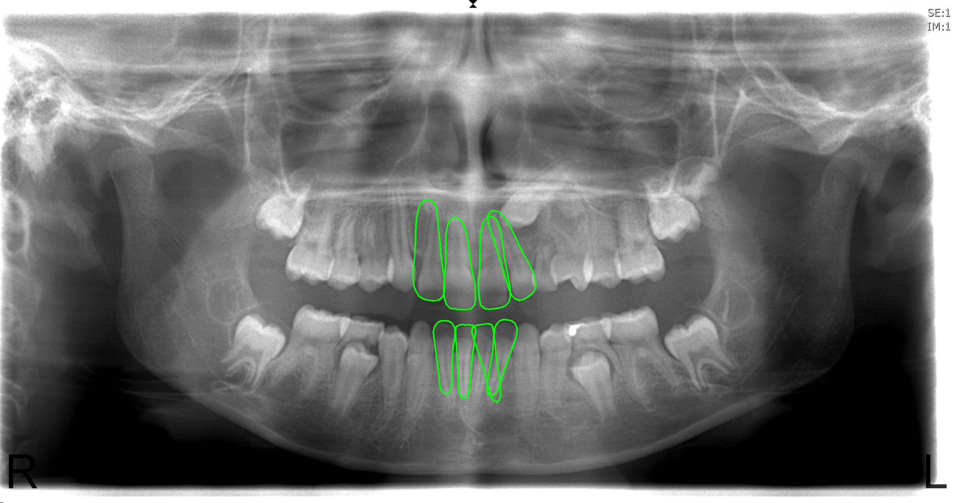
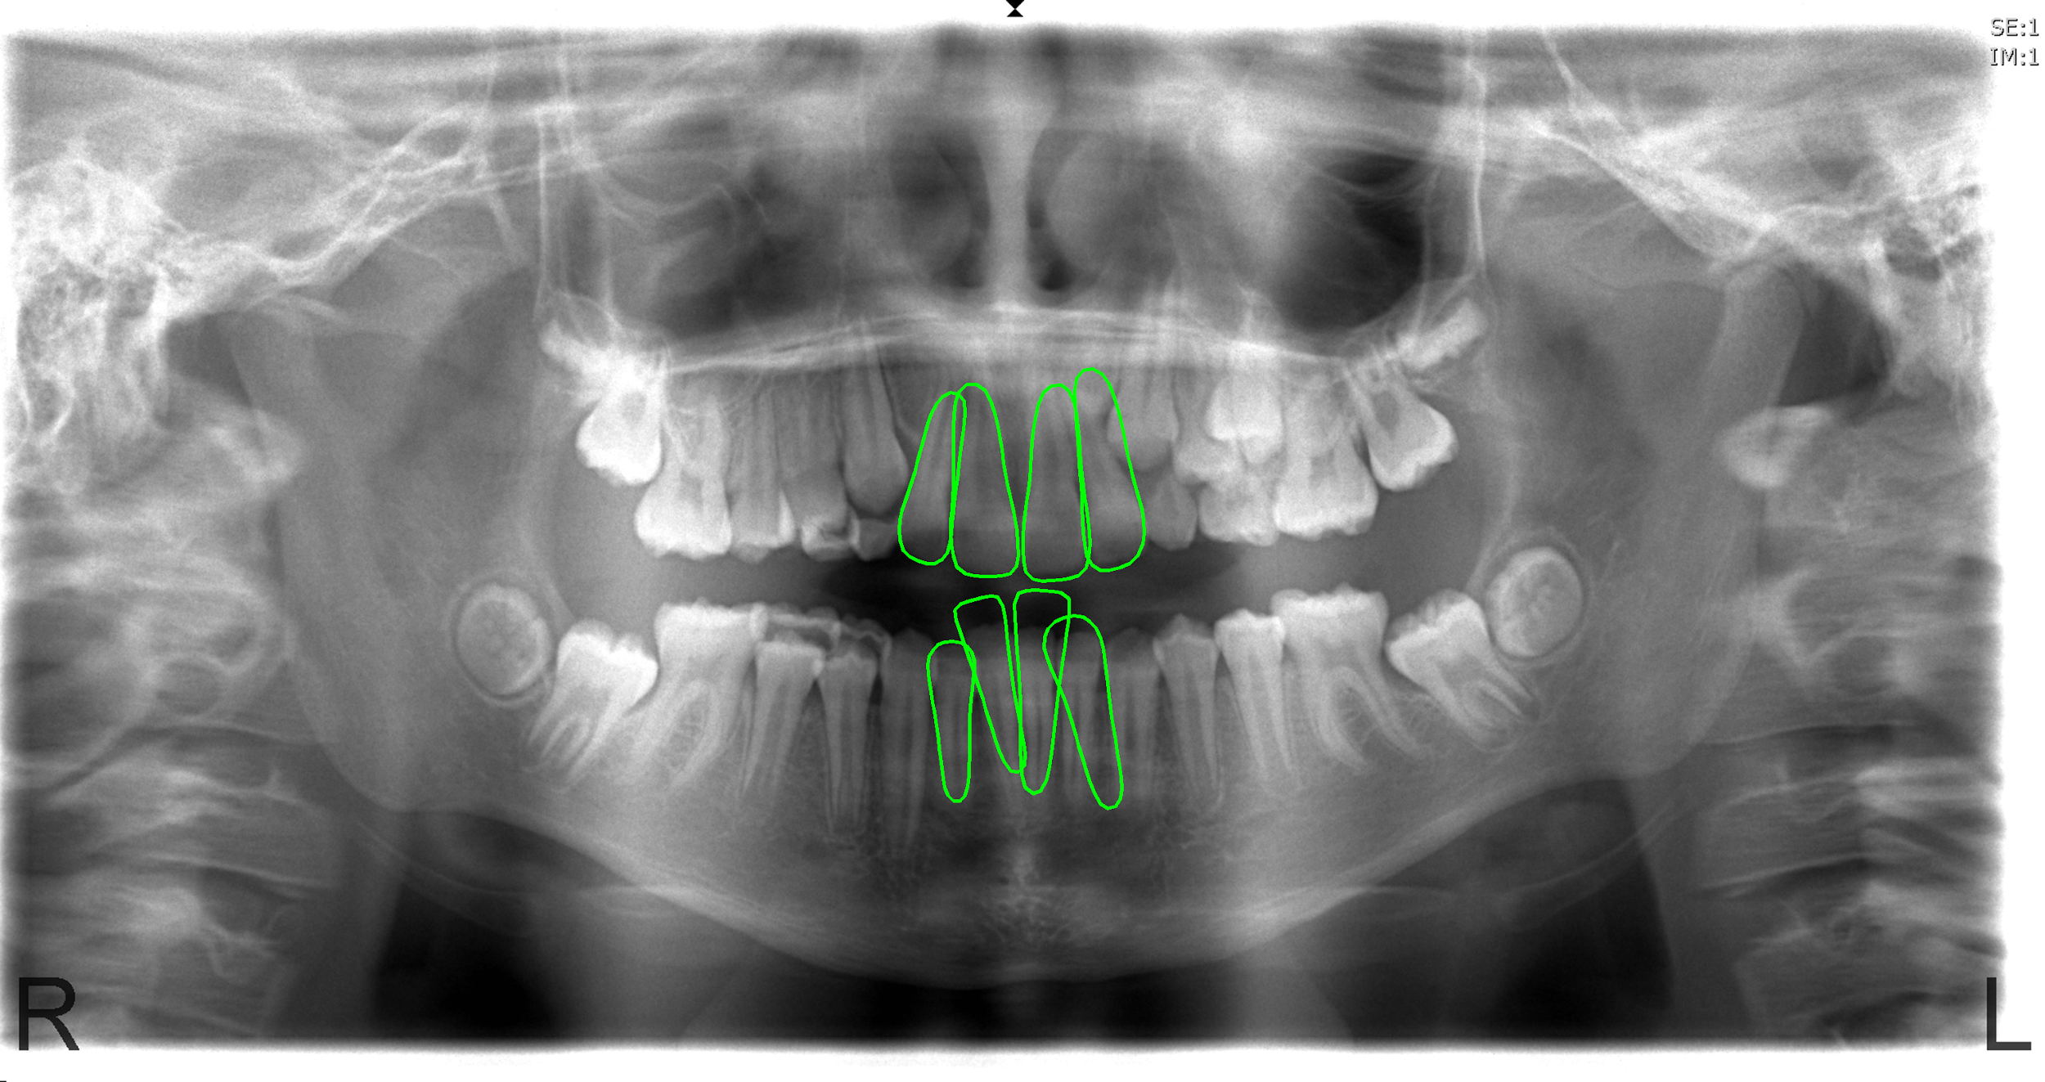
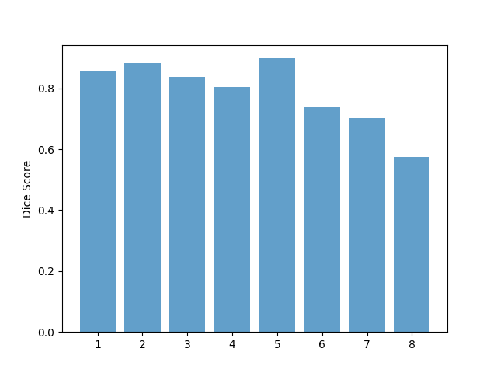
Results Evaluation:
Bad Results Auto Initialisation
Improved Results Manual Initialisation
Dice Coefficients
Good Results
Radiograph 02
Radiograph 07
Radiograph 07
Radiograph 07
Radiograph 10
Radiograph 13
Radiograph 13
Radiograph 13
Notes:
Models diverged to neighbouring lower incisors in 07 and to neighbouring upper incisors in 13

Slide 31
Challenges Faced:
Possible Extensions:
Poor Initial Estimate
Small Training Set
Initial estimate using Convolutional Neural Network
Choosing ‘k’ and ‘m’ by cross-validation
Non-linear dependencies between the shape parameters ‘b_{i}’ can be handled by non-linear PCA using Artificial Neural Network or Support Vector Machines
ASM for all four upper (or lower incisors) and then iteratively half the number of incisors to fit and so on.

Slide 32
Questions ?

